Slide 1
WELCOME TO St. John’s Anglican Church
The Stations of the Cross
Depicting the events of Good Friday from the Trial to the Tomb

Slide 2
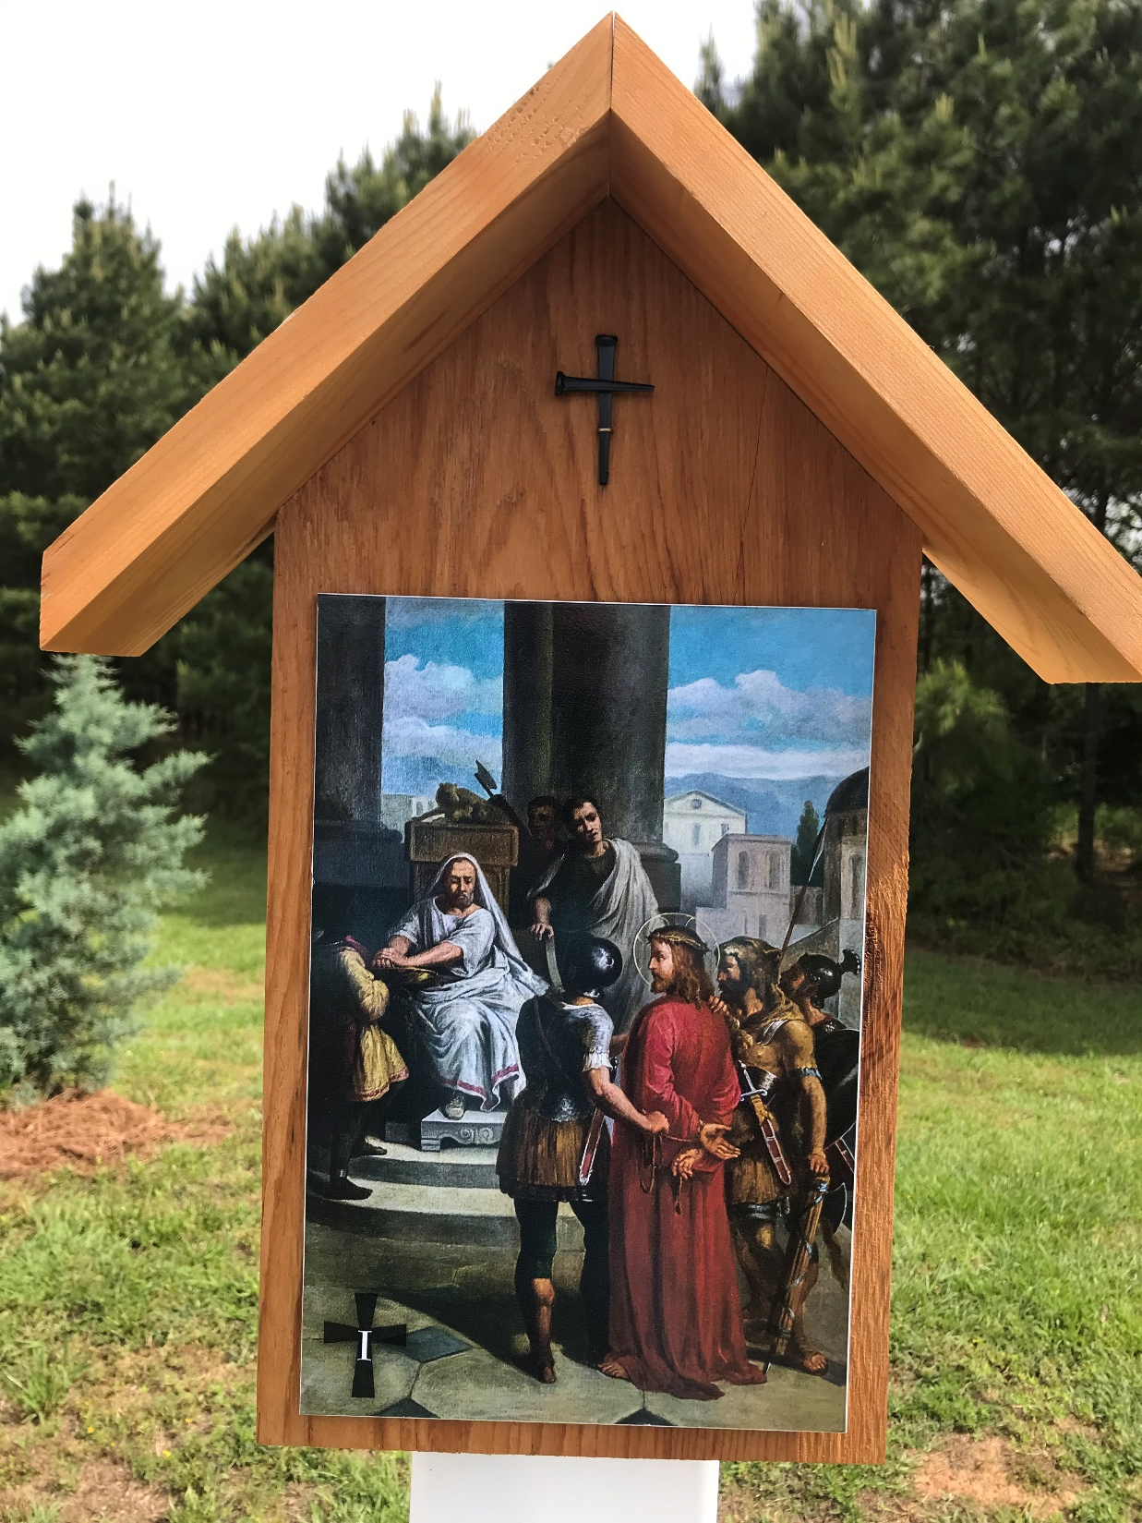
Jesus is condemned to death
Station 1

Slide 3
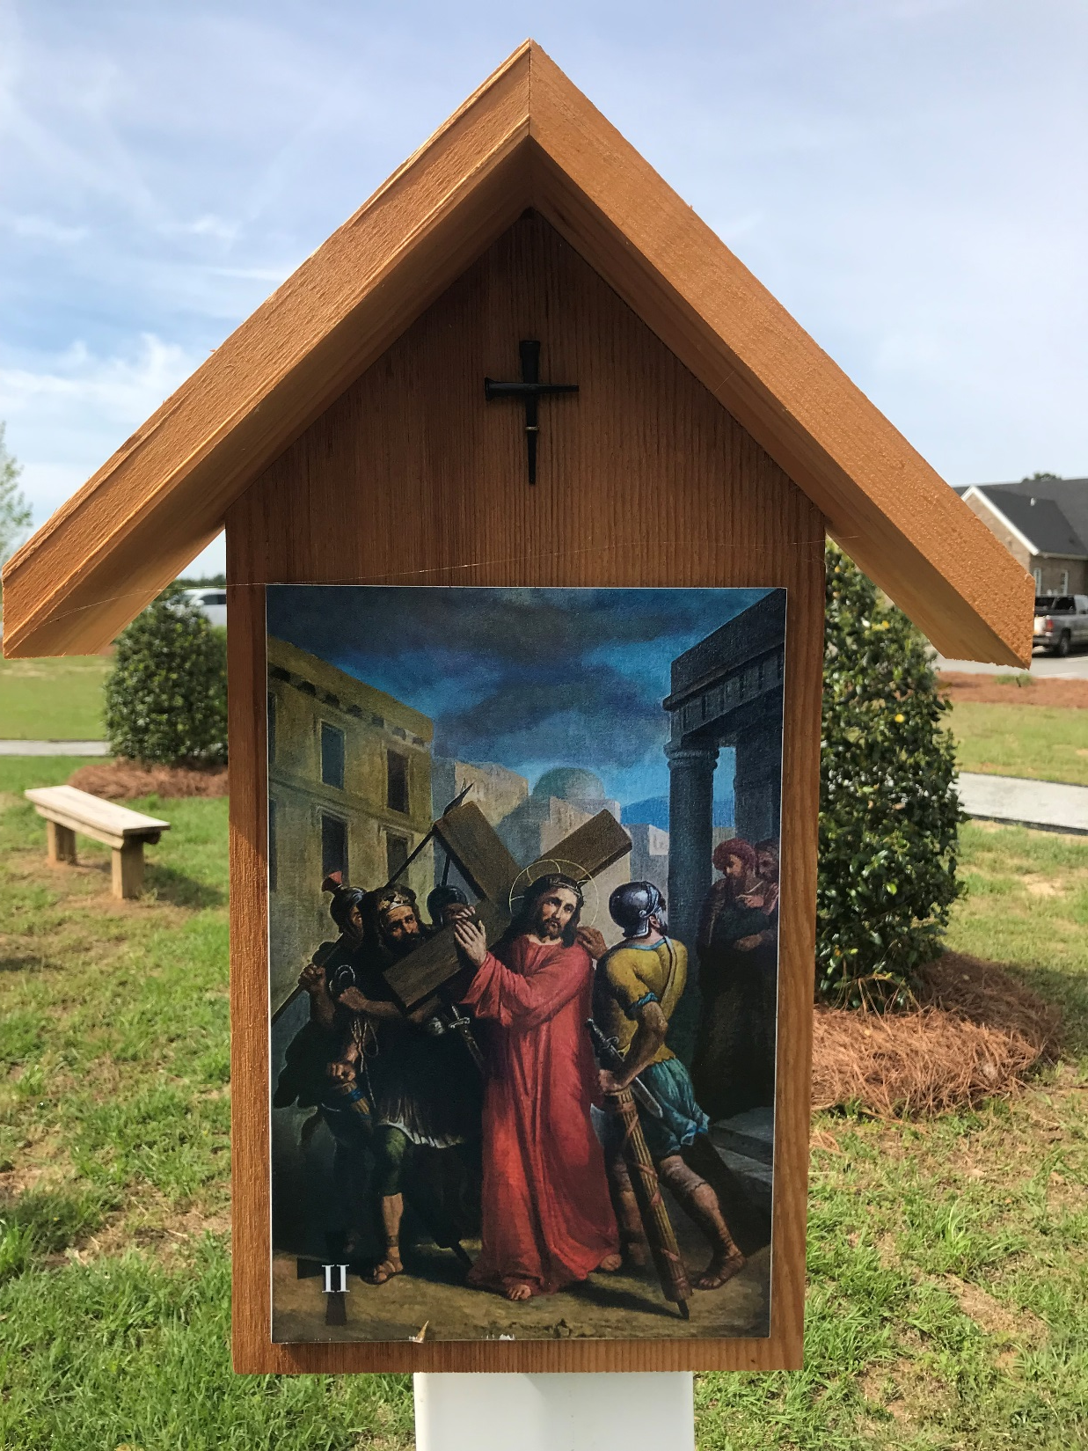
Jesus carries his cross
Station 2

Slide 4
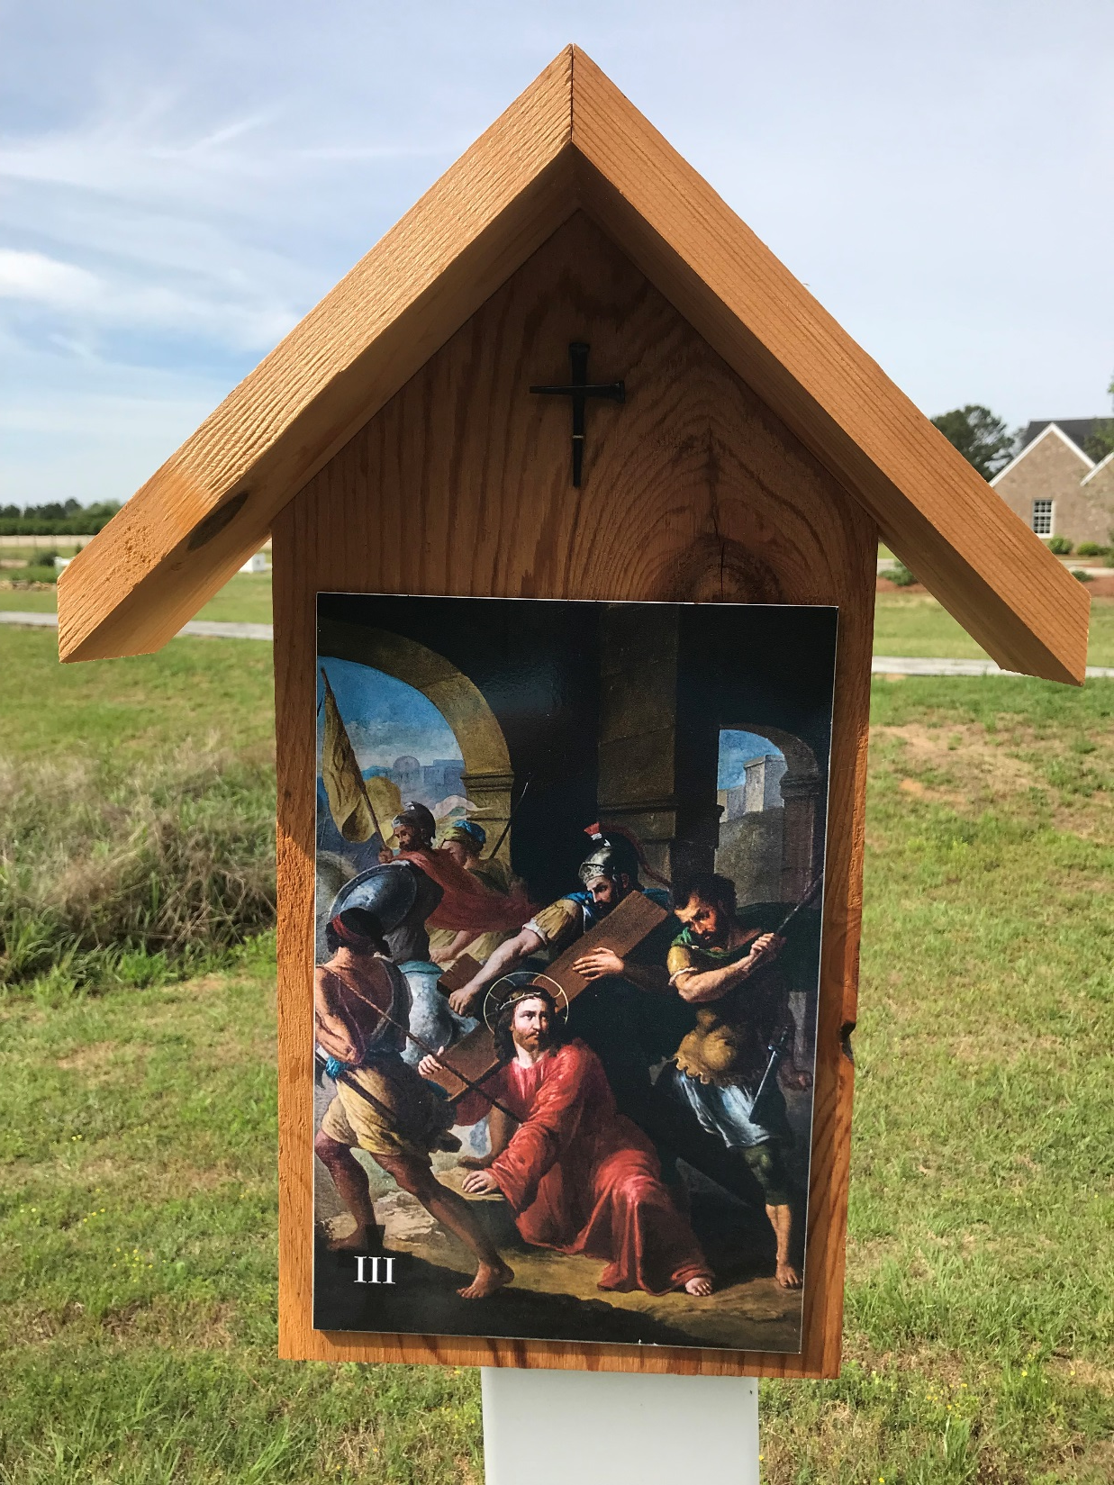
Jesus falls for the first time
Station 3

Slide 5
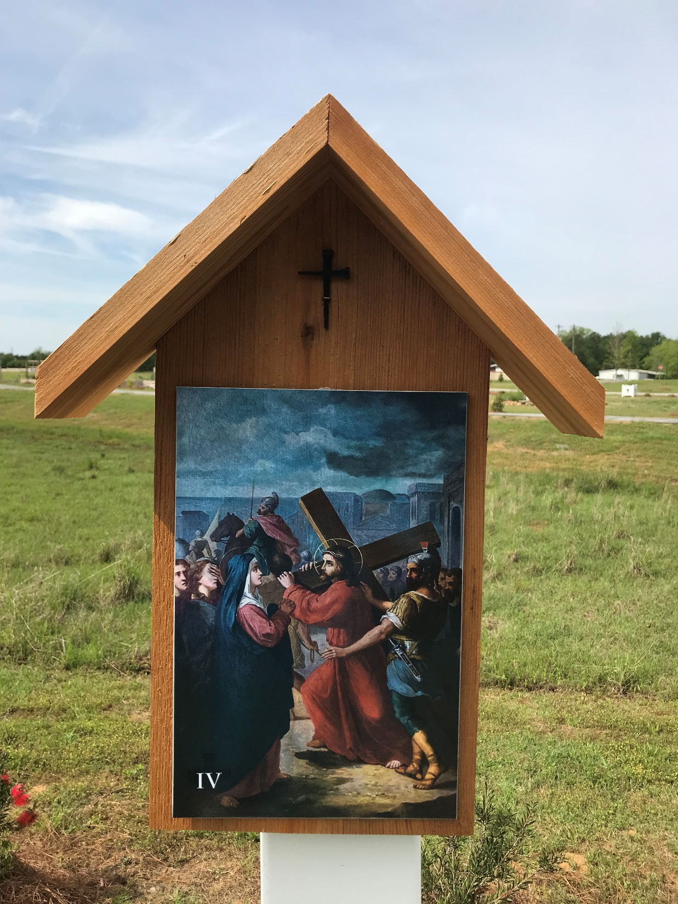
Jesus meets his mother, Mary
Station 4

Slide 6
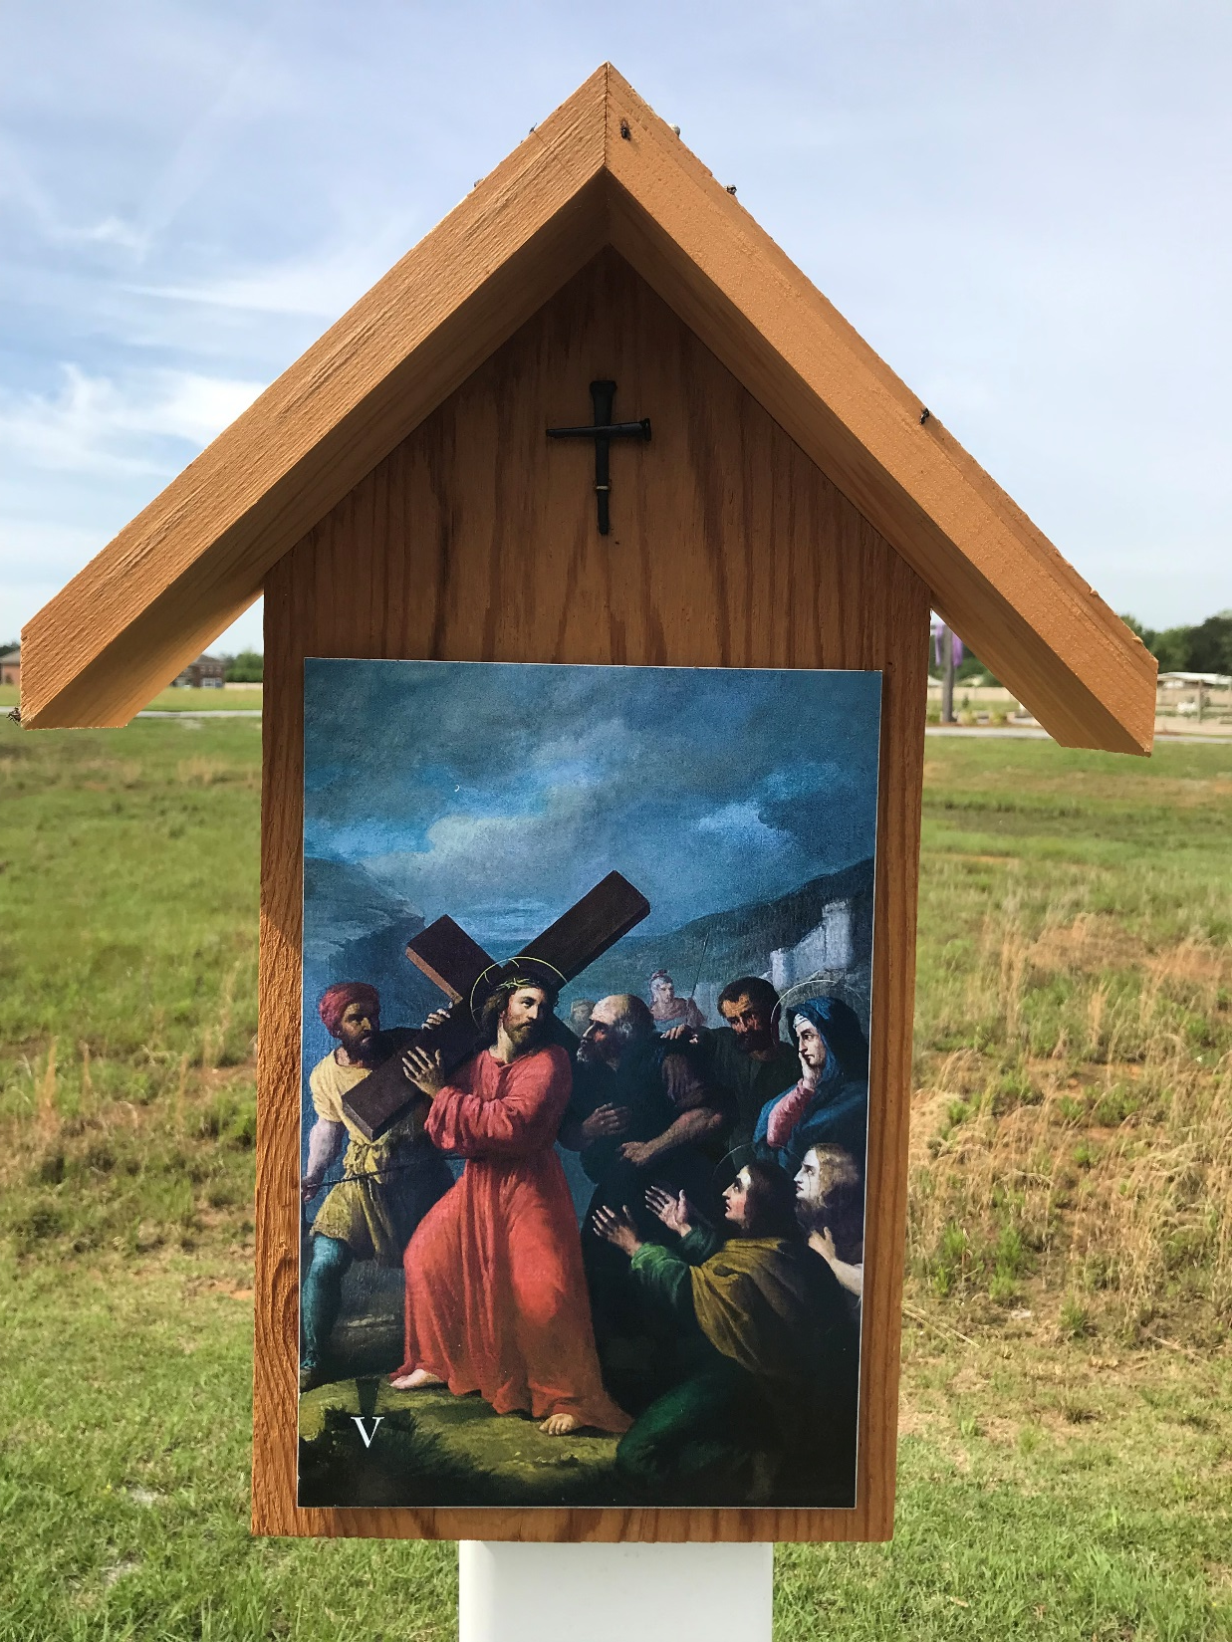
Simon of Cyrene helps Jesus carry the cross
Station 5

Slide 7
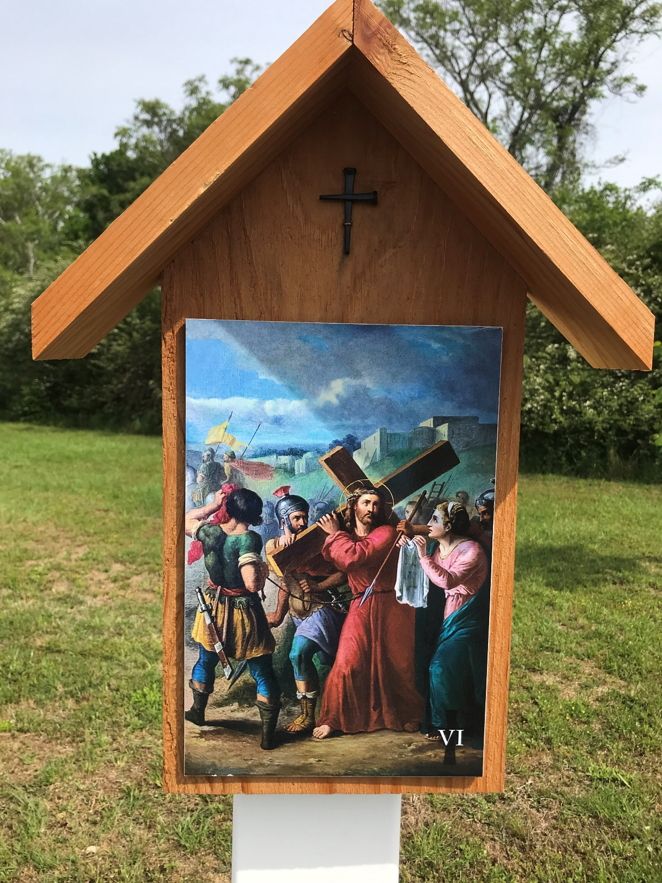
Veronica wipes the face of Jesus
Station 6

Slide 8
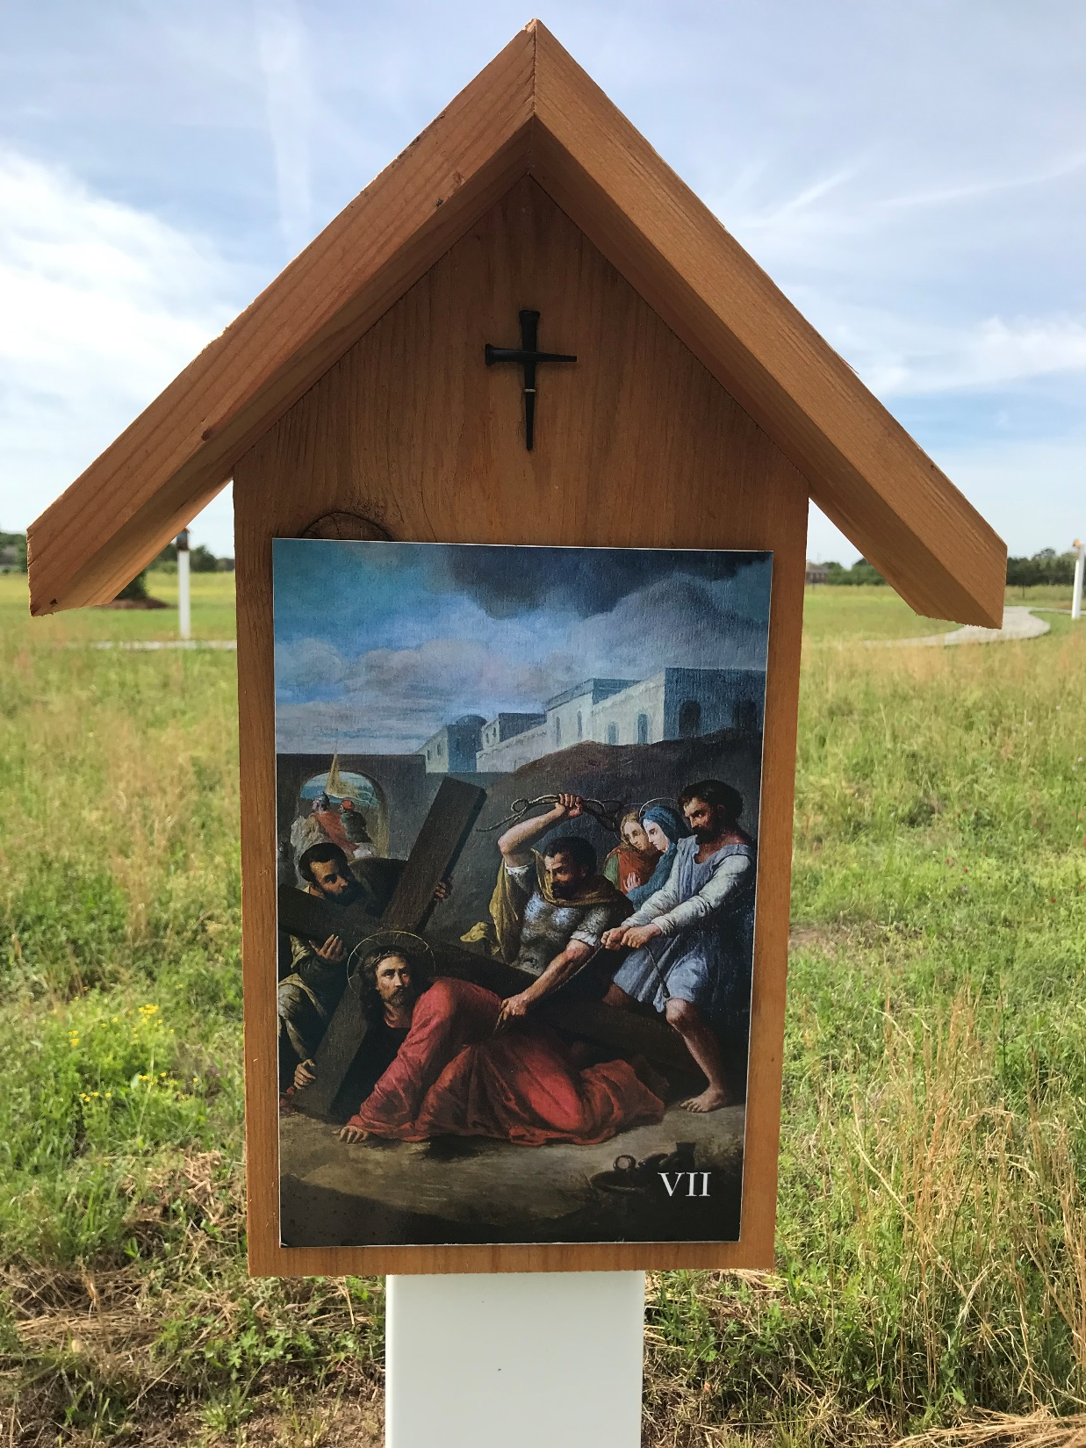
Jesus falls for the second time
Station 7

Slide 9
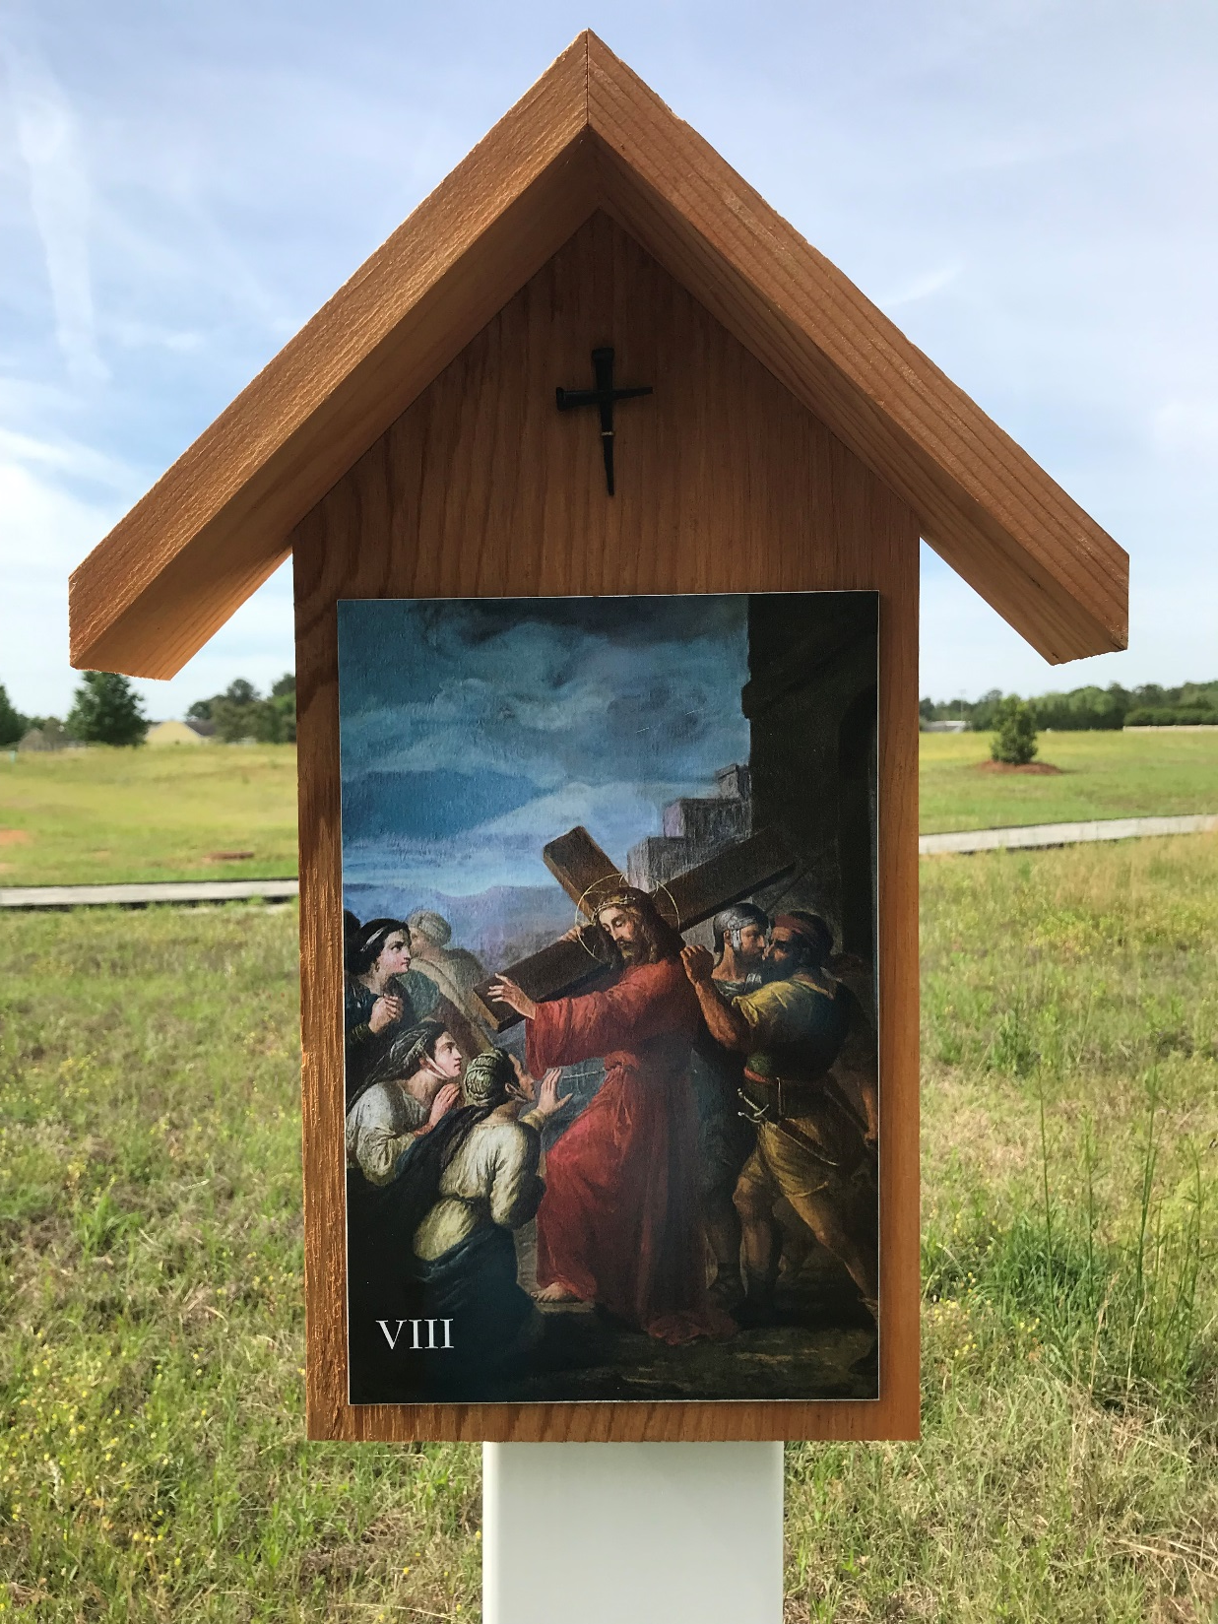
Jesus meets the women of Jerusalem
Station 8

Slide 10
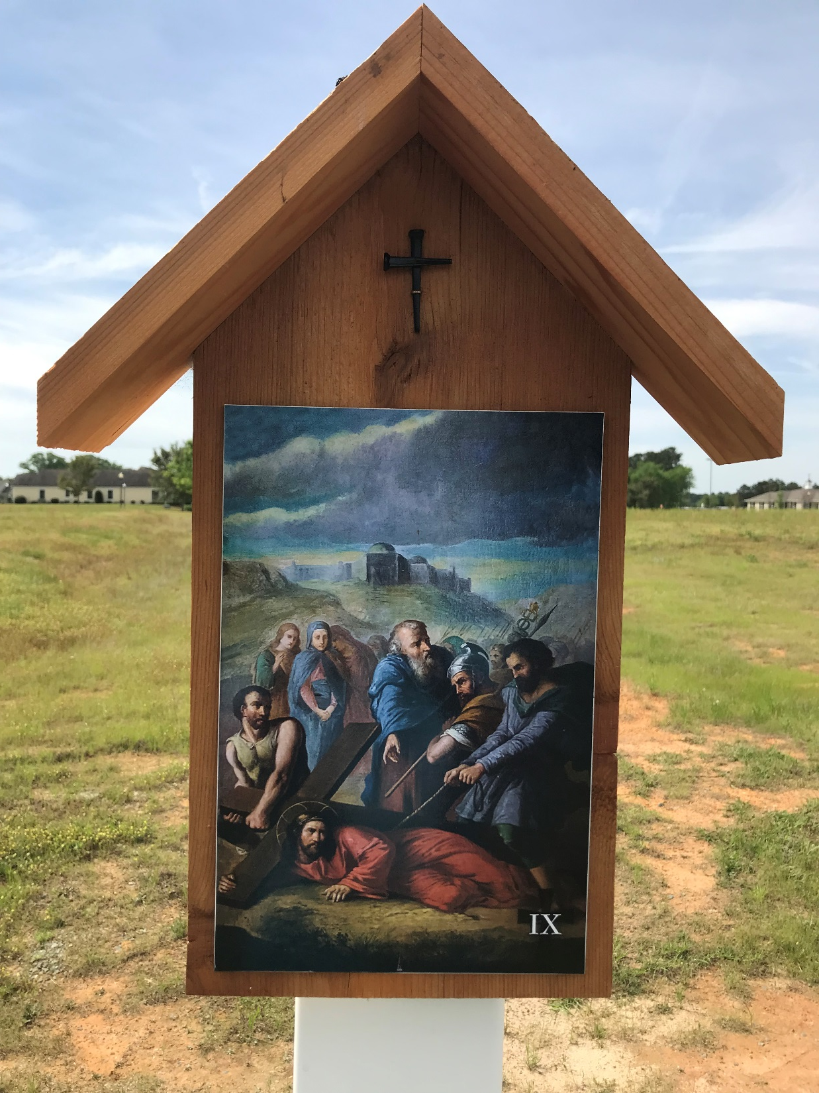
Jesus falls for the third time
Station 9

Slide 11
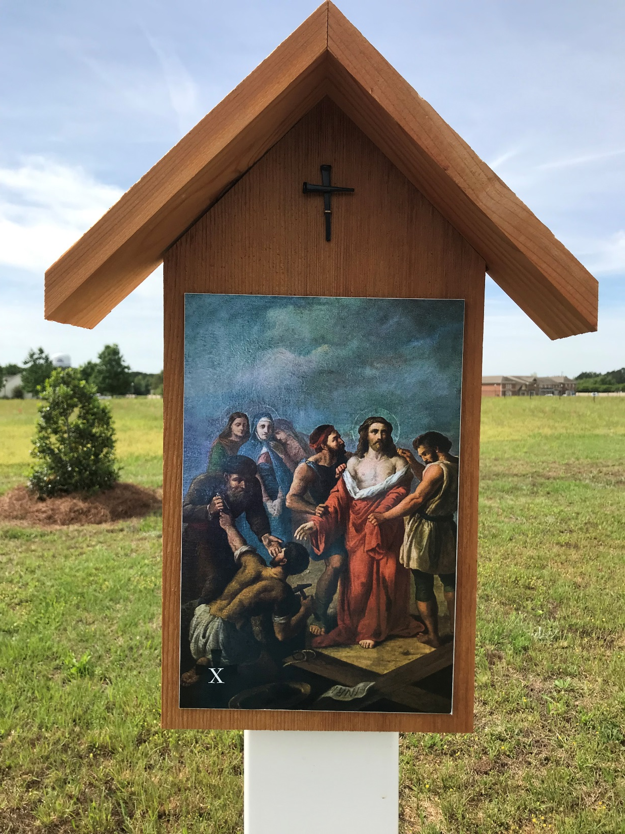
Jesus is stripped of his clothes
Station 10

Slide 12
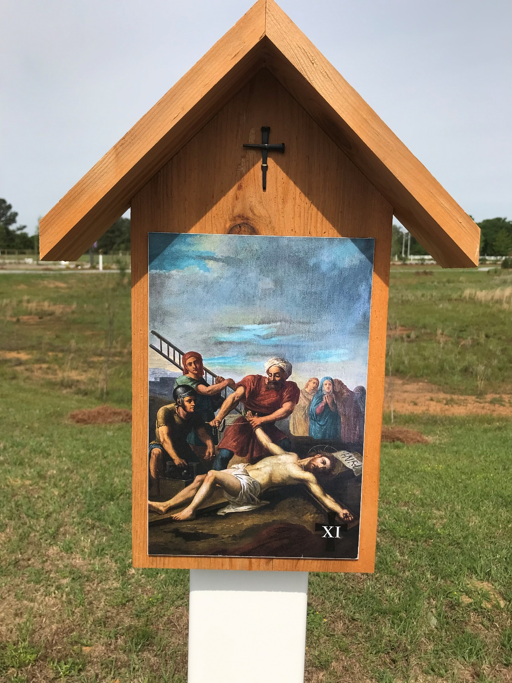
Jesus is nailed to the cross
Station 11

Slide 13
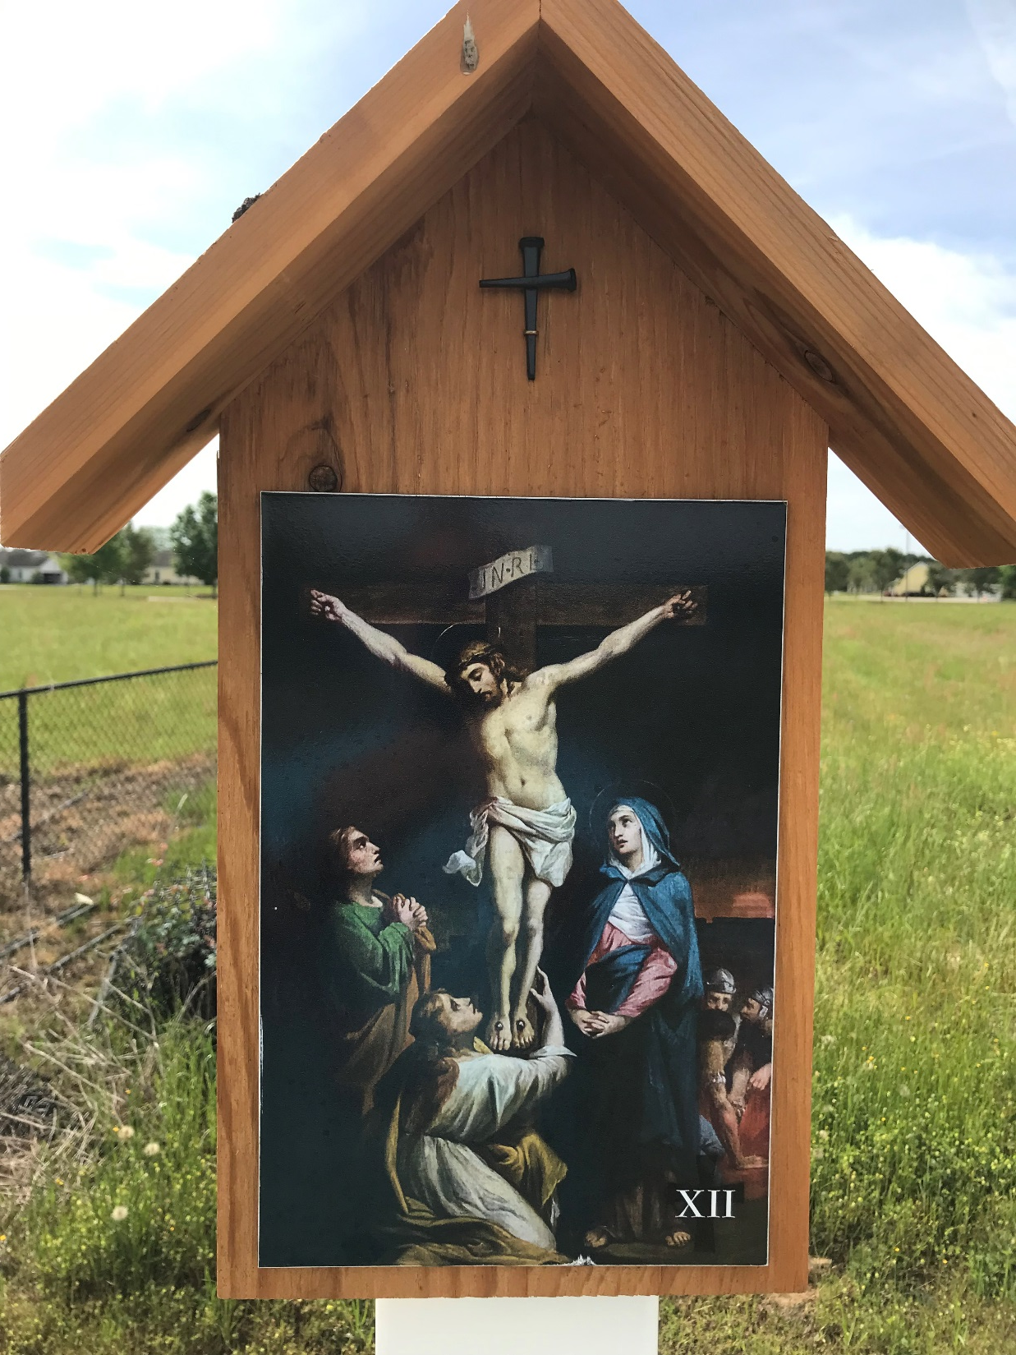
Jesus dies on the cross
Station 12

Slide 14
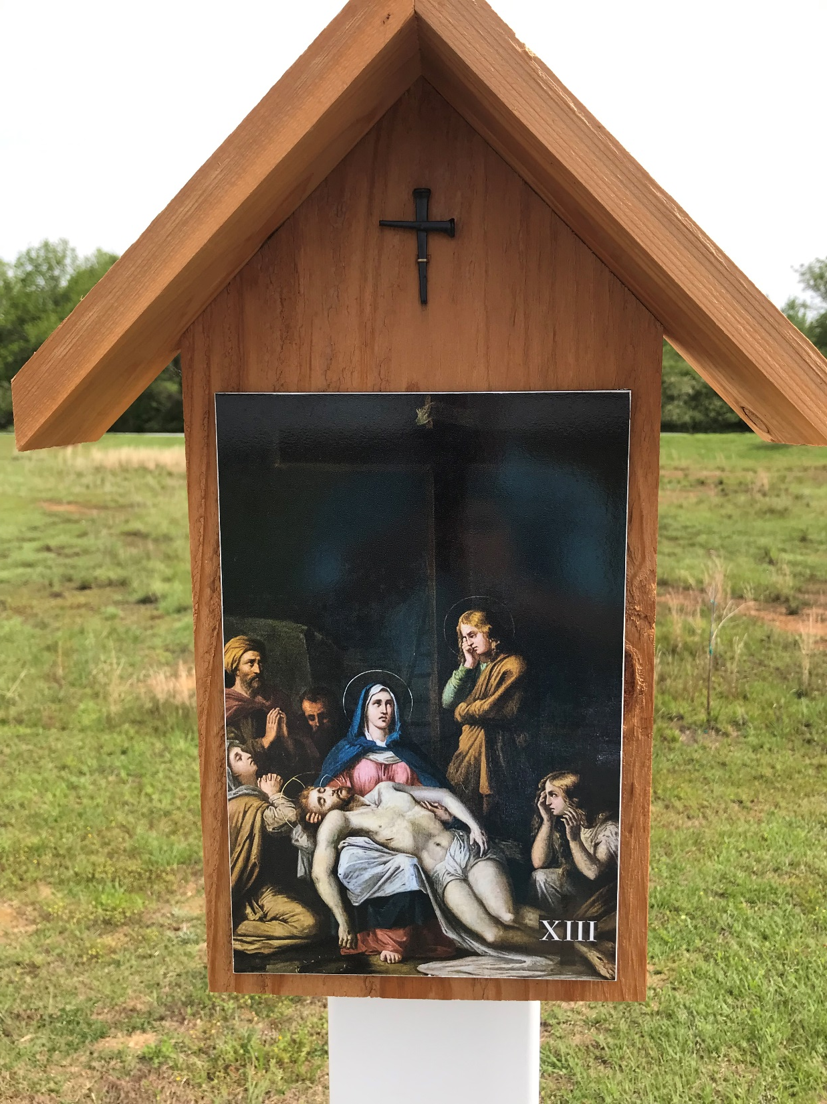
Jesus is taken down from the cross
Station 13

Slide 15
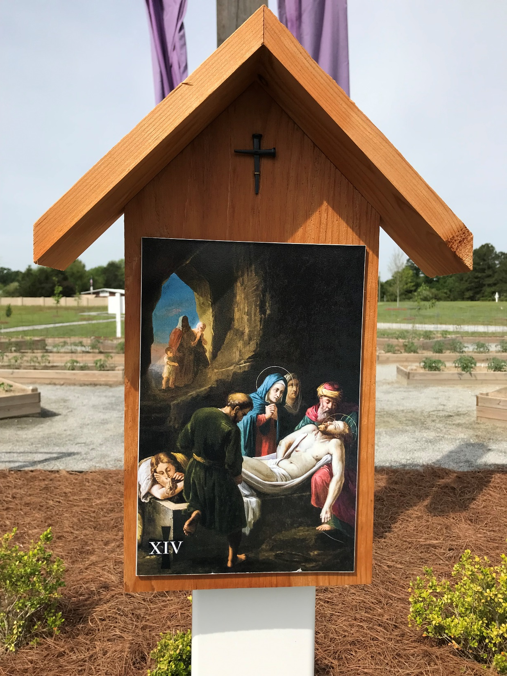
Jesus is placed in the tomb
Station 14

